Slide 1
Virtual Payment Platform System Architecture Overview
Samantha Ngong
Notes:
good evening everyone, i am samantha and i’ll be presenting the system architecture for a virtual payment platform designed for company xyz

Slide 2
Platform Overview
01
Notes:
First I’ll introduce you the platform and the features it has, then i will walk you through how the client server architecture works, how i use redis for fast caching, the complete system architecture and also the tech stack and thre reason i decided to go with it

Slide 3
Executive Summary
Overview
Features
Virtual payment platform to process digital payments through virtual cards
Integrates authentication, card management, transaction processing, and wallet services
Notes:
Before I dive into the details let me give you a summary of what the platform is and the features it has. This platform is a payment system that allows users to create virtual cards, process transactions securely and manage their digital wallets through a mobile app.
the system is builts around four core modeules that is authentication and user management, virtual card issuing via third party apis like stripe, marqueta etc, transaction processing system using redis for high speed caching, and lastly wallet service via a third party service like paystack or flutterwave

Slide 4
Architecture Designs
02
Notes:
Now I will dive into the technical details, starting with the client server architecture

Slide 5
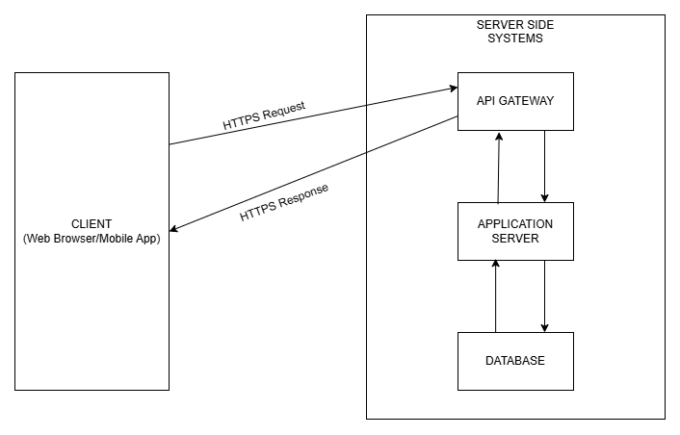
Client-Server Architecture
Notes:
Here we have the client side and the server side. this is where the user interacts with the system through a mobile ap or web browser.
when a user wants to do something for example create a new virtual card this is what happens
- the app send a request over the internet (https means its encrypted and secure)
-the request arrives at the api gateway which checks 3 things (is the user logged in? validates their authentication token. are they making too many requests? prevents spamming. which service handles this request? routes it to the correct place.)
- the request reaches the application server layer where there are microservices
-these services need to save an retrieve data so they talk to the database layer(main database stores all the data(user info, cards, transactions etc) , redis is our fast cache that stores frequently accesses data for quick retrieval)
-finally the response travels back up to the gateway and then the the users device and they see their new virtual card on the screen
- this architecture is scalable means we can just add more servers to handle the load if we get more users

Slide 6
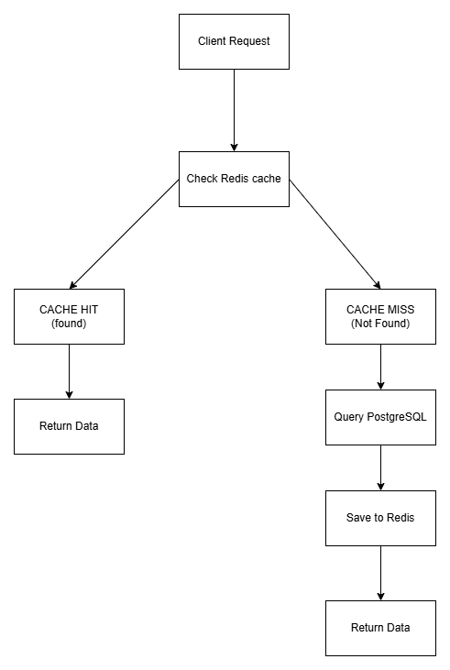
Redis Caching Architecture
Notes:
Databases are relatively slow especially if there a re multiple requests at the same time, redis solves that problem
imagine a user oppens the platform and wants to check their card details
-user requests to see card details
-before going into the database, the system checks redis first to see if we already have this in our fast memory
-if the data is in redis it is called a cache hit and the data response is returned immediately
-if the data is not in redis it is called a cache miss then it queries the databse, gets the data and saves it to redis before returning this data so that next time it is requested it will be a cache hit
redis is used in the system for session management, card data cache, rate limiting (track how many request are made per minute to prevent abuse of the sytem), transaction queue when a payment is made it goes to redis for processing

Slide 7
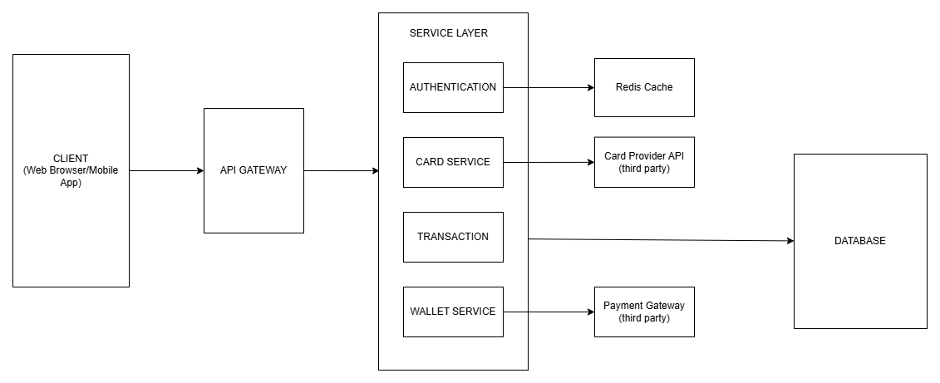
Complete System Architecture
Notes:
Now this is the complete picture of the systems working together
- client layer as mentioned before is for the users. accesed trough mobile apps and web browsers
- api gateway is the single entry point where all request must pass through
-microservice layer where we have 4 independent services
authentication service which handles everything related to user accounts
card service this service handles virtaul card request so it calls third party apis like stripe or marqueta tp provide a real virtual card, also handles card management
transaction service handles all transactions and records them in the database
wallet service manages your didgital wallet and integrating thrd party gatways like flutterwave or paystack
Each service can be updated, scaled, and deployed independently
-the data storage layer
main database stored all permanent data
redis is the cache and queue system as i explained earlier
there are also external integrations
-card apis to provie actual virtual cards
-wallet third party services for payment processing
All these layers communicate through secure APIs. data flows down when making request and back up with responses and each layer intereacts with the layes next to it. makes it easier to maintain and debug

Slide 8
Technology Stack
03
Notes:
Now i will talk about which programming language and databse sytem is best for this program in my opinion

Slide 9
Technology Stack
Language
JAVA for security, scalability, and performance
Database
PostgreSQL for reliable transactions and flexible data storage
Notes:
I think Java with Spring boot framework is best for this system because
Java has extensive libraries and frameworks like Spring Boot that are specifically
designed for building secure, scalable financial applications. 
Built-in security APIs, strong typing, and established security practices make
Java ideal for handling sensitive financial data. 
Ensure high-performance transaction processing.
Widely used in fintech and banking sectors for example even paypal, ensuring availability of experienced developers and community support.
PostgreSQL is chosen as the relational database management system because:
ACID compliance
Atomicity: Transactions either complete fully or not at all
Consistency: maintains data integrity and follows all rules like data types, constraints
Isolation: transactions are processed independently
Durability: Committed data is never lost
Strong constraint enforcement and foreign key relationships ensure data consistency across tables.
Open Source: No licensing costs with strong community support and extensive documentation.

Slide 10
Conclusion

Slide 11
Thank You
Samantha Ngong

